Slide 1


Understanding and Supporting Needs Associated with Possible Neurodivergence
A Needs Led Approach for B&NES and Wiltshire based on the Portsmouth Profile Tool
Sarah Robins- Professional Lead, Neurodevelopmental Pathway
November 2024

Slide 2


A New Approach
The Needs Led Approach is a holistic approach to supporting families in a creative and empowered way. We want to work in partnership between education, health and families to improve outcomes and experiences for children and young people who may be neurodivergent.

Slide 3
Plan
How this training works
Aims
Context and key principles
Needs Led Approach:
Understanding and Identifying Needs- How to use the Needs Led Approach Kit
Supporting Identified Needs- How to create a meaningful Action Plan
FAQs and contact details
Case Study
How to access support

Slide 4


How this Training Works
Webinar training for anyone who wants to understand more about the Needs Led Approach (to supporting the needs of children associated with possible neurodivergence)
Designed primarily for schools and settings but parents can watch it too
It can be accessed anytime by anyone, with unlimited views
Activities throughout- please have pen and paper
Alongside this training, support is available from the ND Pathway
Allow about 90 minutes to watch and complete the activities

Slide 5



Aims
Understand why a Needs Led Approach to supporting children and young people is important
Identifying and Understanding Needs
Understand how to identify needs which may be associated with neurodivergence
Understand more about the nine different neurodevelopmental areas
Understand how to use the observation tables to gain information about a child’s neurodevelopmental profile
Understand how to represent strengths and needs on the strengths and needs sliders
Be able to complete a Needs Led Profile collaboratively
Supporting Needs
Be able to use a Needs Led Profile to create an Action Plan
Working with parents/ carers to empower and support
Working with the Neurodevelopmental Pathway
Know how to access advice and support from the Neurodevelopmental Pathway about identifying and supporting needs

Slide 6
Context
‘We always celebrate individuals and their unique strengths and struggles. The new profile allows for a holistic understanding and targets to be implemented at home and school. There is less frustration at the long delays experienced in the past and the often outdated and limited information that is captured.’
SENCo feedback from the pilot project- October 2024

Slide 7

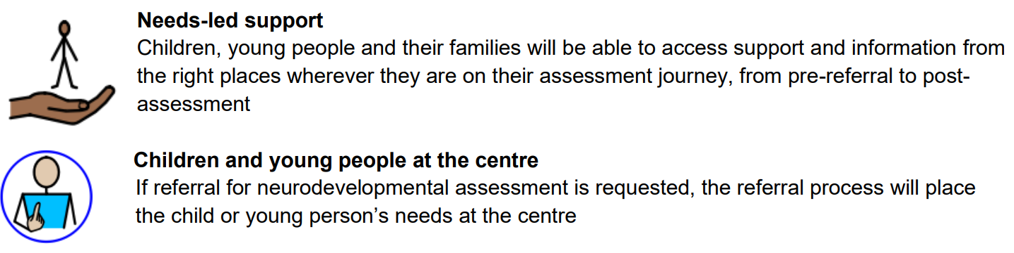
Context
Learning from doing
The Needs Led Approach was devised in Portsmouth and is now widely used across the country. We have been trialling this approach in B&NES and Wiltshire with a number of settings since March 2024. We have adapted the approach in response to feedback from settings, other professionals and parent-carers.
We will also seek to support the needs of those around the child in understanding more about how to help the child meet their potential

Slide 8



Key Principles
New Referral Process
Understanding and meeting needs must be central to the referral process. The Needs Led Approach replaces previous referral pathways for autism and ADHD assessments in B&NES and Wiltshire from 1st January 2025.
Collaboration
The Needs Led Approach is a collaborative approach between children, families, settings and other professionals. The Neurodevelopmental Pathway and local parent carer groups work closely together to support you to achieve this.
Needs-Led- Informed by the Neurodiversity Paradigm
If we can understand and support needs, this will lead to improved outcomes for children and their families

Slide 9
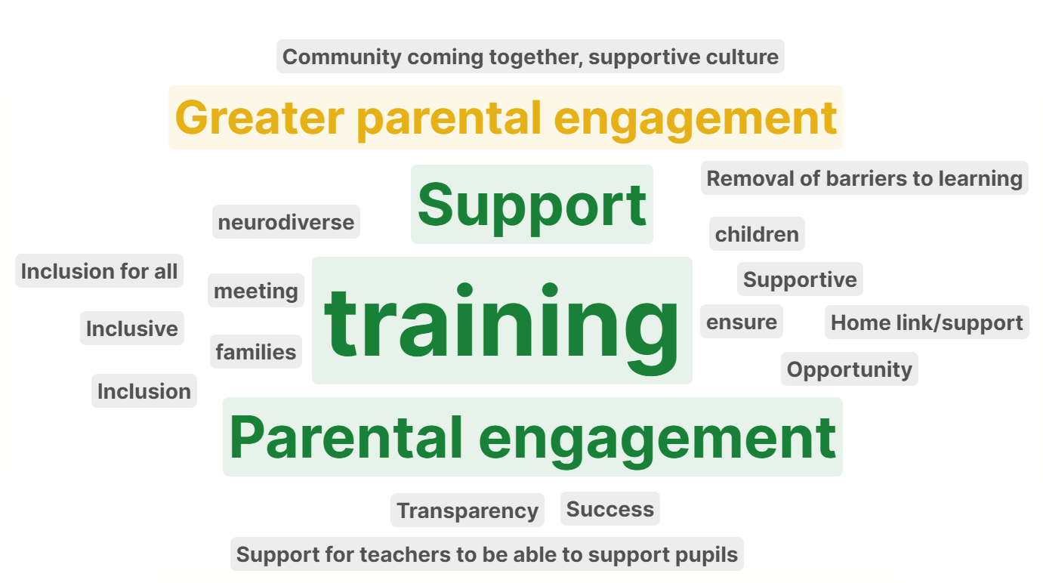
Key Principles
Source: Survey of schools for Partnership of the Inclusion of Neurodiversity in Schools, November 2024

Slide 10
Needs Led Profiling
Understanding and Identifying Needs
‘[The Needs Led Profile] has enabled teachers to pinpoint additional needs when they can’t quite put their finger on what is going on’
SENCo feedback from the pilot project- May 2024
‘We have really felt like we have been listened to and heard! Nothing was too much and no question was unanswered. I am grateful that [child] was brought onboard to the meetings’
Parent feedback from the pilot project- October 2024

Slide 11
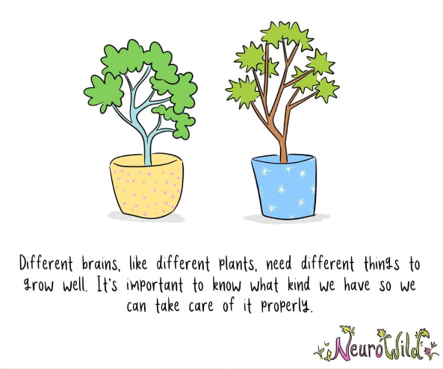

Slide 12
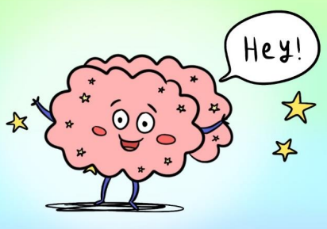

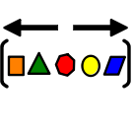
The Neurodiversity Paradigm
What does neurodiversity mean?
‘neuro’- relating to brain function
‘diverse’- showing a great deal of variety; very different
Notes:
Neurodiversity is defined as the range of differences in individual brain function and behavioural traits, regarded as part of normal variation in the human population

Slide 13

The Neurodiversity Paradigm
What does neurodiversity mean?
‘Kaninchen und Ente’ (‘Rabbit and Duck’) from the 23 October 1892 issue of Fliegende Blatter

Slide 14
Neurodiversity in Life
Activity- Think about the people you know (colleagues, students, family and friends)
What are the noticeable effects of neurodiversity?
What are the good things about everyone processing the world differently?

Slide 15
Neurodiversity in Life- Possible Strengths
Did you think about any of the following?
Speech and Language e.g. great vocabulary, knowledge of technical words
Energy Levels e.g. being lively and bubbly
Attention and Impulse Control e.g. being able to concentrate for long periods of time, having lots of ideas
Emotional Regulation e.g. being calm
Motor Skills e.g being great at football
Sensory Processing e.g. enjoyment or avoidance of certain sensory inputs
Flexibility and Adaptability e.g. someone who can ‘go with the flow’ or ‘the organizer’
Social Interaction and Social Relationships e.g. someone who is happy in their own company
Cognition e.g. someone with fantastic memory

Slide 16
Neurodiversity in Life- Possible Needs
Did you think about any of the following?
Speech and Language e.g. stammering, difficulties remembering words
Energy Levels e.g. being tired or lacking in energy
Attention and Impulse Control e.g. distracted quickly
Emotional Regulation e.g. ‘up and down’ emotionally
Motor Skills e.g taking longer to write or complete craft activities
Sensory Processing e.g. sensitivities which form a barrier to accessing aspects of life
Flexibility and Adaptability e.g. someone who finds it hard when plans change or they’re not in control
Social Interaction and Social Relationships e.g. someone who can find conversations difficult
Cognition e.g. someone who doesn’t remember things well

Slide 17
Neurodivergence
‘Neurodivergent: People whose brain works differently from the ‘neurotypical’ majority. Neurodivergent people may be autistic, dyslexic, have ADHD, etc. In schools this is often referred to as ‘Special Educational Needs’ (SEN), but we prefer ‘neurodivergent’ as it’s more positive.’
(from ‘Improving BANES’ mainstream schools for neurodivergent pupils: A short report’, Off the Record and B&NES Youth Forum)
Notes:
So, we recognise that neurodiversity is the typical variation of difference in how we all process the world. This makes us all unique and brings all manner of qualities to the people we know,. This is called the Neurodiversity Paradigm. We need to now consider how this is difference to what we mean by ‘neurodivergence’. Here is a helpful explanation from the B&NES Youth Forum.
So neurodiversity is something we can consider when we look at humans as a whole. Neurodivergence relates to particular individuals who have brains which work differently to the majority. Neurodivergent individuals may have SEN because the world tends to be set up to meet the needs of the majority, and they may find that it is harder for them to fit in to systems because of their neurodivergence. Here is a cartoon which explains this:

Slide 18
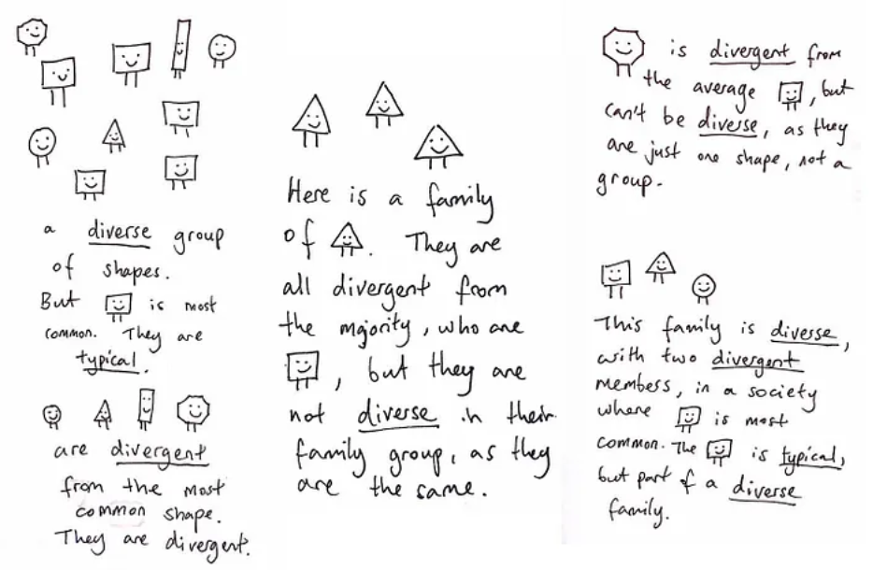
“What a wonderful way of seeing the world” | by Sonny Hallett | Medium

Slide 19




Possible ND Strengths
Attention to detail | Methodical approach | Deep focus
Unique approach | Creativity | Observational skills
Memory for facts | Determination | Visual skills
Accepting of difference | Honesty and loyalty | In-depth knowledge
Harriet Cannon (2018). Autism: the positives. Disability Services, University of Leeds
Notes:
“understanding, embracing and celebrating different ways of thinking and doing” can be very powerful.
This slide shows some examples of positives which you may notice in your child.
Every child is unique and will have different strengths and needs, which may change over time.

Slide 20
Possible ND Needs
What do you notice? | What’s the experience? | What’s the need?
Stammering | ‘Being around so many amazing people who stammer has made me question why I was so ashamed of my speech.’ (Liss from the Youth Exchange Project, Stamma) | Help me stop feeling ashamed of the way I talk.
Reduced eye contact | ‘My child doesn’t look at me. I don’t feel like we have a connection. It’s really hard’. (Parent during telephone consultation with ND Pathway) | Help me find other ways of connecting with my child.
Solitary play at breaktime | ‘I’ve seen my child during playtime if I’ve been walking past school. He’s always by himself. It breaks my heart’ (Parent during telephone consultation with ND Pathway) | Help me understand that my child needs time alone in the busyness of the school day. Help my child join in with play if that’s what they want.
Young person appears to be struggling to concentrate | ‘My teacher gets frustrated with me when she thinks I am not concentrating. I get frustrated too’. (Neurodivergent student from B&NES Youth Forum Neurodiversity Campaign’) | Don’t push me to work or get frustrated. If I appear to be very tired, I might need to rest my head on the desk to help me recharge. A quiet word asking if I want to talk might help me.
Notes:
Sometimes, needs are not what we expect for ND individuals.
The only way to really find out what needs are, is to ask the individual and those around them.
A need for a parent may not be the same as a need for the child.

Slide 21
How to use the Needs Led Approach Kit
‘This helps us understand how we can meet need and changes the way we think’
SENCo feedback from the pilot project- July 2024
[the Needs Led Profile] opened my eyes to so many areas ….that were actually possibly neurodivergent traits; things I had never even realised and things I had never understood that were now making sense’
Parent carer feedback from the pilot project- October 2024

Slide 22
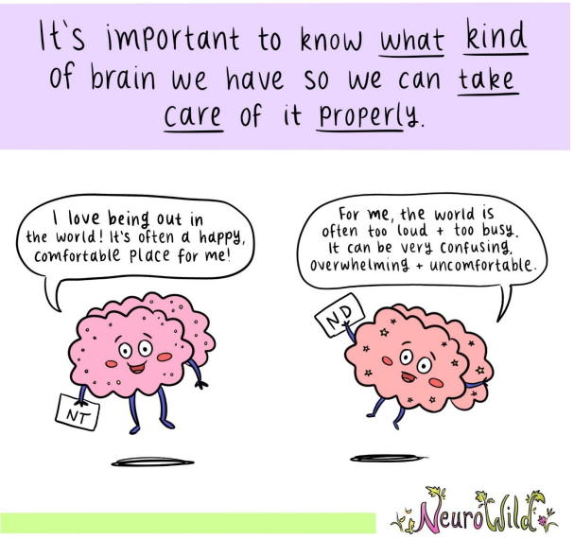
Aims of Using the Needs Led Approach
A different approach to identification of needs
Focus on identification and support, rather than diagnostic focus
Supports a neuroaffirmative approach and recognises and celebrates neurodivergence
Parts of the profile:
  Manual- with information and research about the nine areas you will be profiling, how to use the Profile and Action Plan
  Observation Tables
  Profile and Action Plan
  Resources Pack

Slide 23
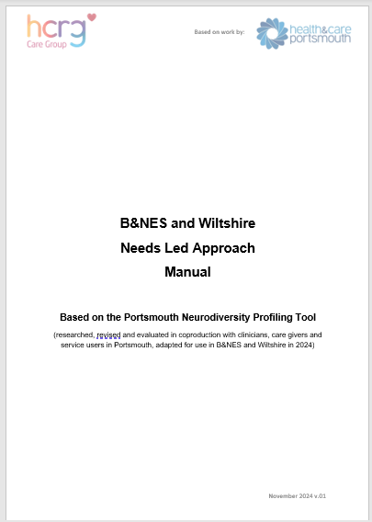
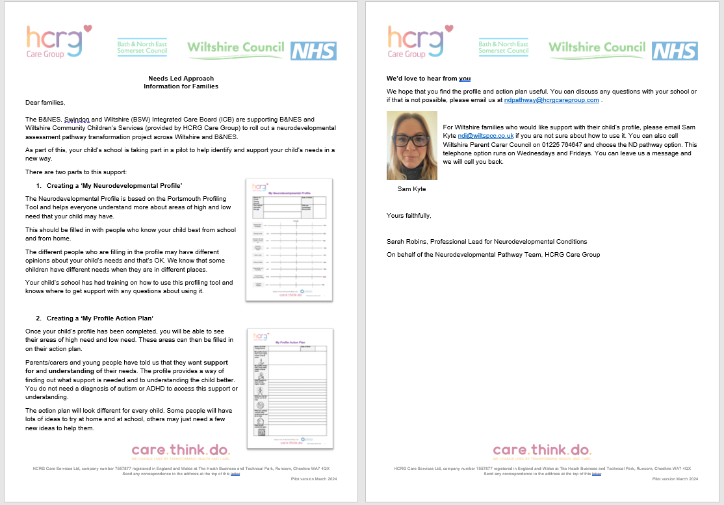
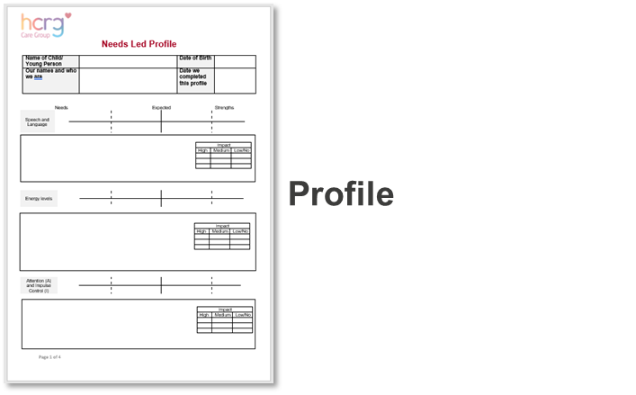

Identifying Needs using the Needs Led Approach- What you need:
Manual
Information for Families Letter
Observation Tables (for child’s developmental level)

Slide 24




Before you start
Somebody recognises some needs related to possible neurodivergence in a child or young person
A Needs Led Approach could be a good way to find out more about their strengths and needs, but first consider:
  Is it a good time to be working with the family in this way?
  Are there concerns about the child’s sleep or nutrition?
  Is there already support being offered to the family or child from other services? How can this be pulled together?
  Is it the right time to be considering neurodivergence or do other pieces of work need to be completed first?
  What does the child think about finding out more about their profile? Are they happy for others to be working together to think about what may be helpful for them?
  Who is the right person to be leading on creating and reviewing the profile and action plan? Do they need to access this training? Or join a drop in with the ND Pathway team to update their knowledge and skills?
Notes:
Are there things going on which will make it difficult for the family to engage with this process at the moment?
Poor sleep or nutrition can have a big impact but can be improved. See the manual for more information.

Slide 25


Overview
The Needs Led Approach has three levels:
Level 1 – Identifying and supporting needs and differences
Level 2 – Reviewing and adjusting support
Level 3 – Seeking advice from the ND Pathway where needs are not being met and having a significant impact
ND Pathway can provide support and information for schools and settings available via Teams drop in sessions, email support and duty line at all levels
Support for families available via parent carer advice line and support and information sessions
The main objective at each level is to understand needs and differences, provide advice, guidance and appropriate support. Children/young people may move through from Level 1 to Level 2 or Level 3 when needs and differences indicate a higher level of impact.

Slide 26

Identifying Needs using the Needs Led Approach- Level 1
Somebody recognises some needs related to possible neurodivergence
School and home and the child (where appropriate) work together to agree whether a Needs Led Approach would be helpful to explore these needs more. Use the ‘Information for Families’ letter to help parent/carers understand more about the approach and how to find out more.
School and home and the child (where appropriate) use the Observation Tables together to identify areas of strength and need
Use the information from the Observation Tables to complete the strengths and needs profile
Use the profile to help agree support ideas for the action plan. Review and continue.
Work together to identify needs using the profile kit. Agree actions to help meet need.
It’s helping. Keep on with the actions and agree how to monitor and keep communicating together
Review

Slide 27






Identifying Needs using the Needs Led Approach- Observation Tables
Notes:
There are seven sets of Observation Tables which are available on our website.
These are documents to help everyone consider the child or YP’s development, based on what they notice about the child.
We recommend you consider the child’s developmental level and choose the Observation Table which matches their learning level.
For example, if a child in year 7 is working 2-3 years behind, you could use the KS2 tables to help understand more about their profile.

Slide 28








Identifying Needs using the Needs Led Approach- Observation Tables
Speech and Language
Energy Levels
Attention and Impulse Control
Emotional Regulation
Motor Skills
Sensory Processing
Flexibility and Adaptability
Social Interaction and Social Relationships
Cognition
Notes:
Let’s look in more details at the Observation Tables
Each observation table has descriptions of development organised into these nine areas.
This is to help us understand more about the young person in a structured way.
The observations tables are by no mean and exhaustive list of descriptions but can help us get started in pinpointing any needs so we can target support.
The observations are not diagnostic in anyway either. You may find that the descriptions are helpful in starting conversations rather than being perfect descriptions of what you, the family and young person are noticing about their development.
There is some more detail about each of these areas in the manual, if you would like to find out more

Slide 29



Identifying Needs using the Needs Led Approach- Observation Tables
Within each of the nine areas, there are descriptions of development which may be considered to indicate:
Strengths
Needs
Expected Development

Slide 30

Identifying Needs using the Needs Led Approach- Observation Tables
We recommend that you go through the Observation Tables with the parent carer and young person (if appropriate) and select the descriptions together that you feel best describe the child’s development
You can highlight the best descriptions of the child for each area
You can use different colours for home observations and school observations- it’s OK to have different opinions
These observations then build the profile of the child
Notes:
The information from the Behaviour Tables will help you consider where on that profile area the child sits. A cross (parent/carers), a circle (school) and a triangle (child/young person) can be used to show the child/young person strengths, expected skills and needs.
Any marks closer to the left-hand side indicates more needs and marks on the right-hand side fewer needs. Marks closer to the middle indicate more expected behaviours for that child’s age and stage.

Slide 31
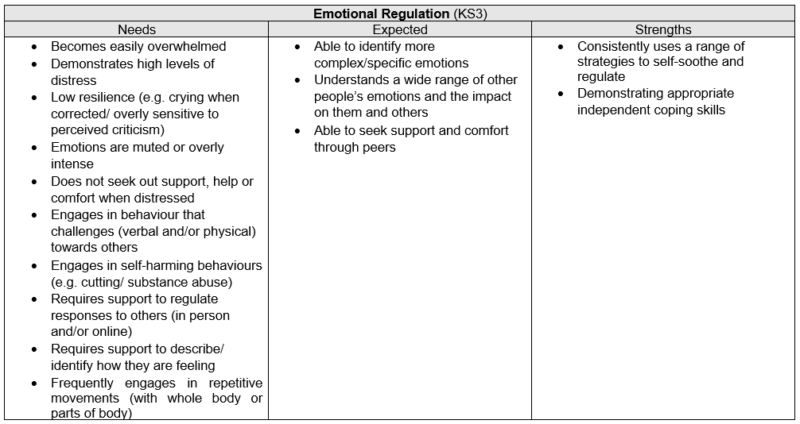



















Identifying Needs using the Needs Led Approach- Observation Tables
Key
Home and YP
School
Both
Notes:
Let’s look in more details at the Observation Tables
Here is an example of a Emotional Regulation table from the KS3 tables
This looks like the young person is presenting quite differently at home from school.
They are demonstrating high levels of observable distress at home, including self harm.
At school they seem to be more ‘shut down’ with muted emotions.
Both home, school and the young person has identified that they are able to seek support and comfort through their peers, and home have identified some strategies that seem to really help. There is an opportunity here to find out more about what these are and whether they could be used in school.
There are clear needs here, and this would need to be reflected on the slider on the child’s profile.

Slide 32
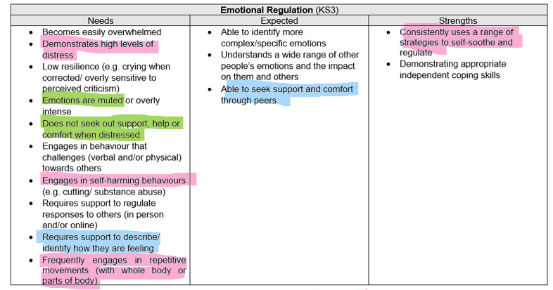
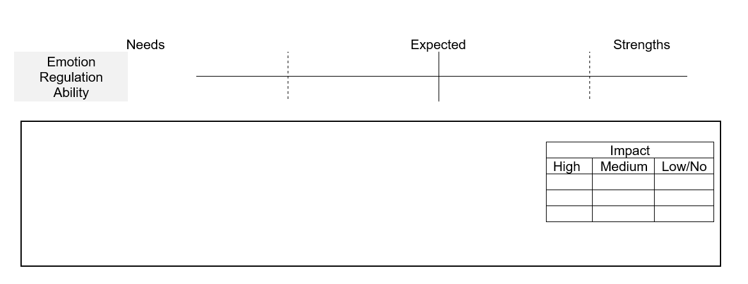
Identifying Needs using the Needs Led Approach- Observation Tables
Very distressed at home every night and self harm. We don’t see this at school but recognise she can shut down.
Notes:
Within the free text box, there is the opportunity to record any information about where you have decided to place the marker on the slider.
There is also the opportunity to record the level of impact that this is having. You might record different level of impact observed at home and at school.

Slide 33
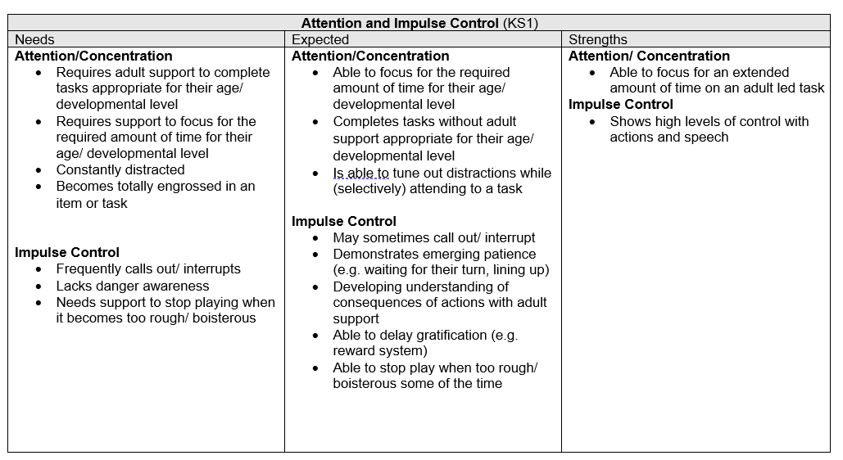














Identifying Needs using the Needs Led Approach- Observation Tables
Key
Home
School
Both
Notes:
Let’s look in more details at a different Observation Table which has been filled in
Here is an extract from the attention and impulse control table from the KS1 observation table
This time, the family and school are mostly making similar observations.
School have noticed strengths in extended levels of concentration. At first, mum wasn’t sure from a home perspective but then remembered the child doing some woodwork with Grandad a couple of weekends ago and being amazed how long he worked for!
Mum said that she frequently has to intervene when he is playing with his brother and feels that this support is needed because the two of them get carried away.
Let’s look at how these observations would be reflected on the profile.

Slide 34
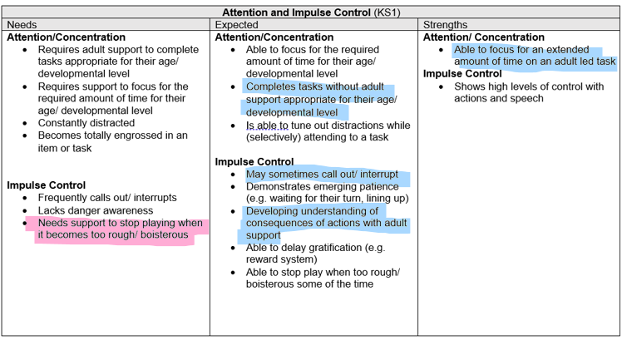

Identifying Needs using the Needs Led Approach- Observation Tables
Expected attention. Impulsive with brother as they wind each other up.
Notes:
As you can see, there are observations indicating needs, expected levels and strengths.
This doesn’t mean you have that anything has gone wrong. It would be unusual for a child to have behaviors only in one section and not have some skills in others. We expect that most children will have this mixed profile. It is important to notice how many of the child’s behaviors are in each of the sections and make a best fit decision.
If attention and impulse control are very different from each other, this can be marked on the slider.

Slide 35
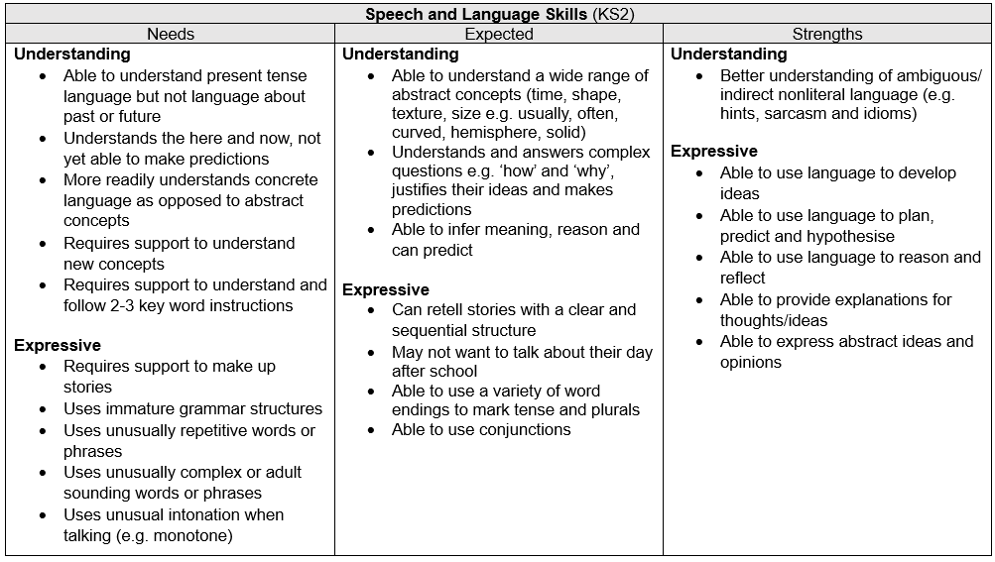
















Activity- Identifying Needs using the Needs Led Approach- Observation Tables
Key
Home
School
Both
Notes:
Let’s have a go at adding these KS2 observations in the Speech and Language area to a slider.
Draw a slider on a piece of paper. This is a horizontal line like we have seen before. On the left side we will indicate ‘needs’ in the middle ‘expected development’ and at the right hand side we will indicate ‘strengths’.

Slide 36
Example Slider

Slide 37
Activity- Identifying Needs using the Needs Led Approach- Observation Tables
Key
Home
School
Both
Notes:
Let’s have a go at adding these KS2 observations in the Speech and Language area to a slider.
Draw a slider on a piece of paper. This is a horizontal line like we have seen before. On the left side we will indicate ‘needs’ in the middle ‘expected development’ and at the right hand side we will indicate ‘strengths’.

Slide 38




Activity- Identifying Needs using the Needs Led Approach- Sliders
Notes:
School have noticed more speech and language needs than home. We may often expect this because of the nature of the school environment.
Home aren’t noticing too many speech and language needs in the home environment and he is getting his needs understood at home although his talking might be a bit behind.
Now home understand that some of his talking and understanding needs are having an impact in school, they might be able to support a bit at home. How they can help will be added to the action plan if this is appropriate.

Slide 39
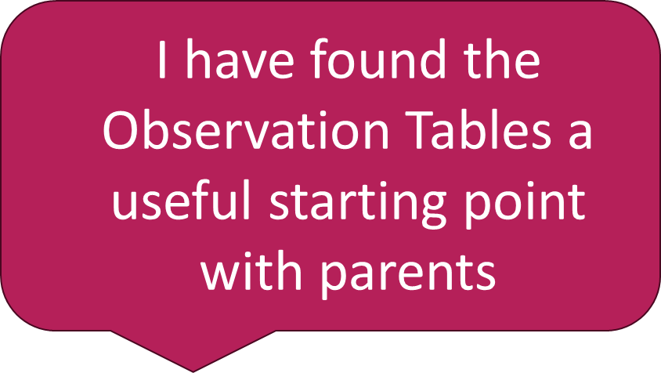
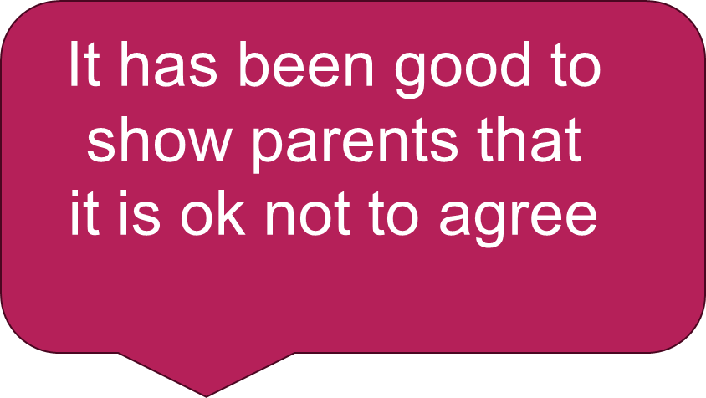
Questions and Comments- Using Observation Tables
Can I share the Observation Tables with Parents?

Slide 40

Identifying Needs using the Needs Led Approach- Level 2
Review the Level 1 Action Plan with the family and child if appropriate
Agree whether there are still unmet needs which are having an impact
There may be unmet needs in just one place e.g. just home or just school
Consider whether the plan needs to be adapted or whether there is other support or advice required
Adapt the plan
There are still unmet needs which have an impact. What’s working? What else can we try? Do we need support/advice from other agencies/people? Adapt the plan.
It’s helping. Keep on with the actions and agree how to monitor and keep communicating together
Review

Slide 41
Identifying Needs using the Needs Led Approach- Level 3
Review the Level 2 Action Plan with the family and child if appropriate
Agree whether there are still unmet needs which are having a significant impact. Consider what other actions could support these needs.
If you are not sure what else to try, attend an ND Pathway weekly drop in by emailing nd.pathway@hcrgcaregroup.com for the link
If you, the family and the young person (if appropriate) think a diagnostic assessment with the ND Pathway could help meet these needs, submit the observation tables, profile and Action Plans to the ND Pathway via the SPA
The ND Pathway team will review the observation tables, profile and Action Plans. They may help you consider additional or different suggestions for actions or will discuss whether a referral for ND assessment is indicated.
If referral for ND assessment is recommended, the ND Pathway team will advise you what steps to take

Slide 42

Identifying Needs using the Needs Led Approach- Level 3
There are still unmet needs which have a significant impact. Further support and advice for the family, professionals or child/young person is required. Attend drop in for advice or email documents for review ND Pathway if considering assessment.
Work together with ND pathway, family and child to adjust plan. Submit information as referral to ND Pathway if indicated
Support drop in sessions on Microsoft Teams with member of ND Pathway team. Email nd.pathway@hcrgcaregroup.com for the links. A chance to discuss cases at any level with the ND Pathway and to access support to consider different support ideas.
You may feel that a diagnostic assessment with the ND Pathway is required to meet the identified needs. Submit the documents to Single Point of Access for the ND Pathway to review. The ND Pathway team will review these and contact you with the outcome of review. This may include extra suggestions for support, recommendation of referral or other advice.

Slide 43
What if Referral for ND Assessment is Recommended at Level 3?
If ND assessment is recommended at Level 3:
It is important to help the young person (and family) understand that
The child and parents must consent to considering an ND assessment
If a diagnosis is given, this is lifelong and will not be removed unless there is significant information which suggests it is not appropriate
A diagnosis of autism/ ADHD does not automatically provide additional support in school such as an Education, Health and Care Plan (EHCP). The majority of children and young people can be supported in school without an Education and Health Care Plan using a Needs Led Approach.
Some career paths and visa applications may ask for any diagnosed conditions to be disclosed
Once referred, a Needs Led Approach to support must continue
Many parents and young people have told us that they seek a diagnosis in order to access support and understanding. For many, this can be accessed via the Needs Led Approach and does not require an ND assessment pathway.

Slide 44
Level 1
Level 2
Level 3
Work together to identify needs using the profile kit. Agree actions to help meet need.
Summary
Support for schools and settings available via Teams drop in sessions with ND Pathway, email support and duty line
Support for families available via parent carer advice line and support and information sessions
Check resources manual for ideas
It’s helping. Keep on with the actions and agree how to monitor and keep communicating together
Review
There are still unmet needs which have an impact. What’s working? What else can we try? Do we need support/advice from other agencies/people? Adapt the plan.
It’s helping. Keep on with the actions and agree how to monitor and keep communicating together
Review
There are still unmet needs which have a significant impact. Further support and advice for the family, professionals or child/young person is required. Attend drop in for advice or email documents for review by ND Pathway.
Work together with ND pathway, family and child to adjust plan. Submit information as referral to ND Pathway if indicated.

Slide 45
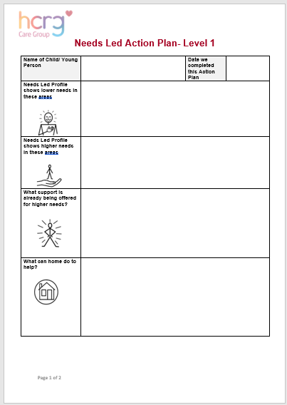
How to create a meaningful Action Plan
‘….[The parent carer advisor] gave me ideas and strategies to try at home. I’ve learned so much about how my children behave and process things throughout this whole process’
Parent carer feedback from the pilot project- October 2024
‘It was really good to see what they’re doing in school and I was pleased to have a copy [of the Action Plan] to take away as it was a lot to take in’
Parent carer feedback from the pilot project- October 2024

Slide 46
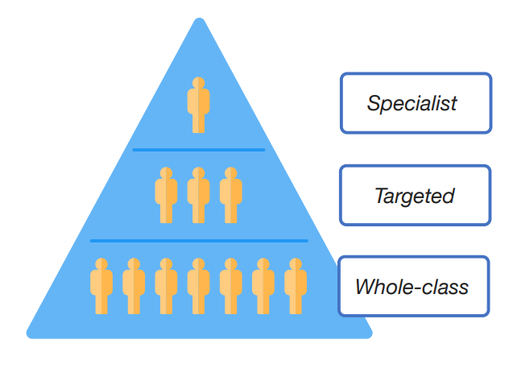

Ordinarily Available Provision
A pupil has SEN where their learning difficulty or disability calls for special educational provision, namely provision different from or additional to that normally available to pupils of the same age.
Making higher quality teaching normally available to the whole class is likely to mean that fewer pupils will require such support. Such improvements in whole-class provision tend to be more cost effective and sustainable.
Thanks to Vikki Vince, Lead School Effectiveness, Wiltshire Council
Notes:
SEN SUPPORT
How can schools identify what is different from or additional to if they don’t understand their universal offer?
Needs to be consistent across all of the school.
Key part here is the link between HQT and OAP. EEF – SEND in MS Schools – whole-class HQT is key – complemented by targeted and specialist support.
Link back to being above national/stat neighbours.

Slide 47


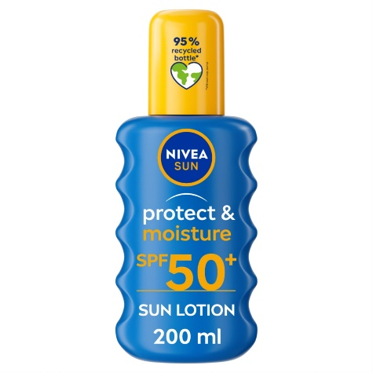


Training
Resources
Thanks to Vikki Vince, Lead School Effectiveness, Wiltshire Council
Notes:
Extras needed become less when we extend the parasol.
Can’t assume everyone is able to do this – settings will need to consider the training and resource needs in order to develop this effectively. Need to think about ‘who’.
Think about Breakfast club, office staff, governors, lunchtime supervisory staff.
Resources – consider how notional budget is spent to support this.
Need to be clear on what is already in school’s gift and where gaps might be.

Slide 48
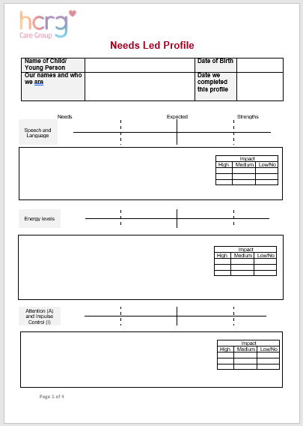

Creating a Meaningful Action Plan
What you need:
Completed Profile
Action Plan
Resources Pack

Slide 49

Key Principles- Collaborate
Collaborate
This involves careful listening. School and home may have different priorities. Actions for each party should be to support the needs identified. Sometimes it might not be what you think. What other professionals are involved? Could those recommendations be included?

Slide 50
Key Principles- Empower
Empower
Parents and young people are experts by experience. They may have experience to share of what works. Build on this.

Slide 51

Key Principles- Communicate
Communicate
Many parents have told us they don’t know what happens in school and they don’t realise all the support that is embedded into quality first teaching. It can be reassuring to hear what is already happening and how this is helping.

Slide 52

Key Principles- Identify Opportunities
Identify Opportunities for School
Think of the parasol analogy. This is an opportunity to identify actions which are likely to make the class or school approach more neuroaffirmative. There may be some specific adaptions as well.

Slide 53

Key Principles- Be Realistic
Be Realistic
Parent carers have told us they feel overwhelmed with signposting. Pick one or two places to look for support for the areas which are having the most impact.
Add what is helping in school already- you don’t need to reinvent the wheel.
Additional ideas can be added at the next review.

Slide 54

Key Principles- Ask for Help
Ask for Help
Consider the different organisations listed in the Resource Pack for ideas for each profile area
Consider training and resources provided by your Local Authority on Local Offer (Rightchoice, Local Offer, Graduated Response)
Giving parents the ‘Information for Families’ letter will help them to access the parent carer groups to support them and share knowledge and experience.
Come to an ND Pathway drop in session to ask for help with Action Planning and learn from others. Email nd.pathway@hrgcaregroup.com

Slide 55
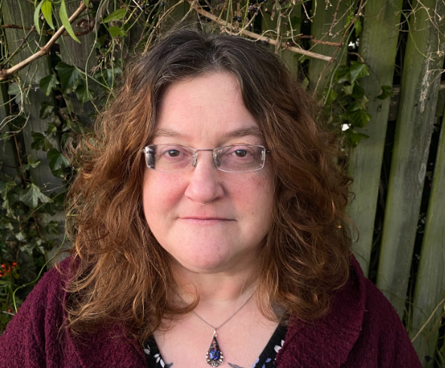

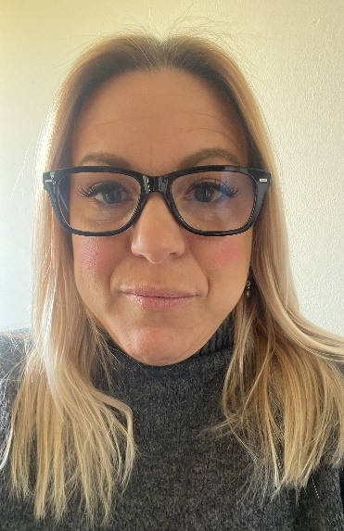

Parent Carer Support
The B&NES Parent Carer Forum ND Support Line helps parent carers understand the Needs Led Approach in Bath and North East Somerset and provide support and advice about this. The line operates a callback system. Parent carers can call 01761 502515 and leave a message. The email address is ndsupport@banespcf.co.uk.
Rachel Hale, B&NES PCF
Wiltshire Parent Carer Council (WPCC) ND advice line is open Wednesdays and Fridays 10am – 5pm. Parent/carers can all the WPCC on 01225 764647 and select option 2. If there is no reply, they should leave a message and they will be called back. They can also send an email to: ndi@wiltspcc.co.uk.
Sam Kyte, WPCC

Slide 56
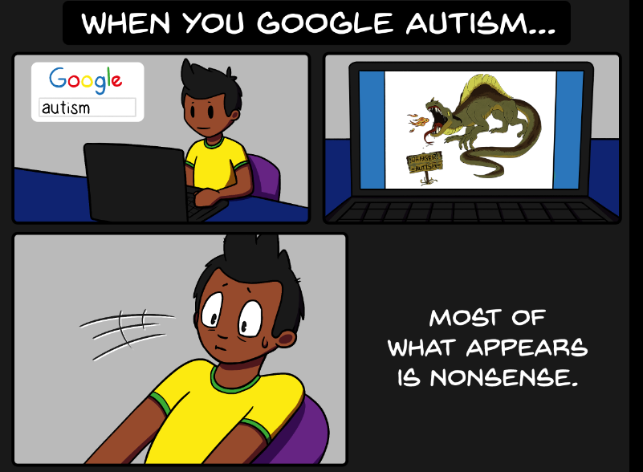


Finding out about Autism
Helps to provide understanding and support
Strategies are likely to be helpful
AmazingThingsHappen.tv
AutismUnderstood.co.uk
Notes:
Many people worry about finding out about autism and ADHD when they don’t have a confirmed diagnosis, but this can be very helpful

Slide 57

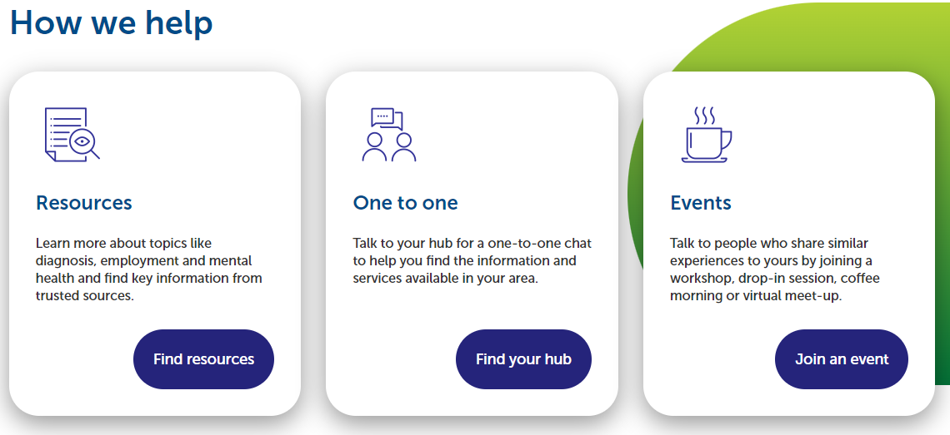
Finding out about Autism
www.autismcentral.org.uk
Guidance on a wide range of topics including friendships, eating, extra support at school.
Free online information sessions including topics including all about autism, support in education, sensory processing, and anxiety, and virtual drop ins with other parents where you can ask questions
Notes:
Our local hub for the South West is the Bristol Autism Support group. On their website you can sign up to receive their emails. They then email out all the regular calendar updates for courses; they give a much wider timeframe than is available on the Autism Central website at present.

Slide 58


Finding out about ADHD
Helps to provide understanding and support
Strategies are likely to be helpful
AmazingThingsHappen.tv
www.adhduk.co.uk
www.adhdfoundation.org.uk
Notes:
Many people worry about finding out about autism and ADHD when they don’t have a confirmed diagnosis, but this can be very helpful

Slide 59
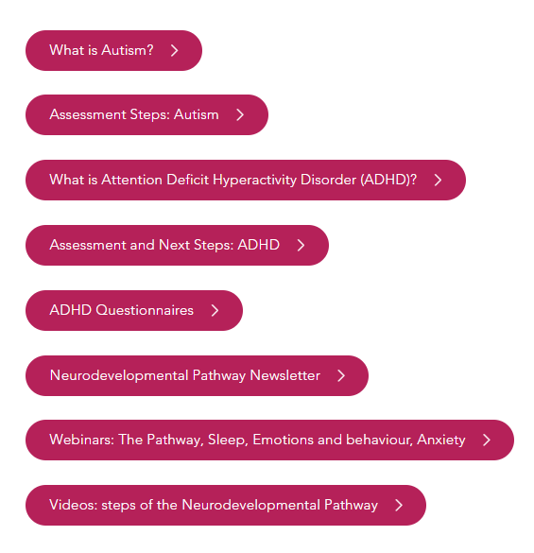

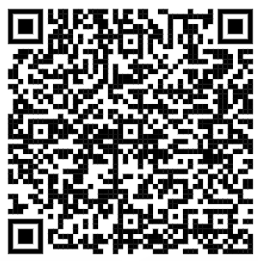
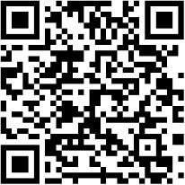
ND Pathway Website
B&NES:
https://bathneshealthandcare.nhs.uk/services/neurodevelopmental-pathway/
Wiltshire:
https://wiltshirechildrensservices.co.uk/services/neurodevelopmental-pathway/

Slide 60

Case Study

Slide 61
Case Study- Aysha
Parent frequently approaches setting saying she thinks her child Aysha is autistic and would like a referral for a diagnostic assessment
Parent says that Aysha has very difficult behaviour at home which is putting a strain on family life and reducing social opportunities
In the setting, Aysha is quiet and achieving age related expectations
How would you use a Needs Led Approach to support this family?

Slide 62
Case Study- Aysha
Arrange a time to talk with mum (and Aysha if appropriate)
Find out what they are hoping for from a diagnostic assessment
Myth busting
Discuss a Needs Led Approach with mum and Aysha (if appropriate) and give the ‘Information for Families’ letter
Give the family some time to think about the approach and whether this is right for them
Use Observation Tables to talk together and understand more about Aysha at home and school. These provide an objective opportunity to talk about her profile of strengths and needs.
Create a profile for Aysha and an Action Plan including support to help the family access some more social opportunities
Follow a Plan- Review- Do cycle with the Needs Led Approach

Slide 63
Case Study- Aaron
Setting has noticed that Aaron is finding it hard to regulate his emotions, is highly distractable and impulsive
The SENCo mentions this at parent- teacher consultations but the family don’t feel that these are issues at home
The setting are finding it increasingly hard for Aaron to access his learning
How would you use a Needs Led Approach to support Aaron?

Slide 64
Case Study- Aaron
Arrange a time to talk with the family (and Aaron if appropriate)
Discuss a Needs Led Approach with the family and Aaron (if appropriate) and give the ‘Information for Families’ letter
Give the family some time to think about the approach and whether this is right for them
Use Observation Tables to talk together and understand more about Aaron at home and school. These provide an objective opportunity to talk about Aaron’s profile of strengths and needs.
Create a profile for Aaron and an Action Plan based on identified needs
Follow a Plan- Review- Do cycle with the Needs Led Approach

Slide 65

FAQs

Slide 66
Frequently Asked Questions
Working with parent-carers
We are worried that the Needs Led Approach may lead to parent carers requesting actions that are unrealistic for our school.
One of the key principles for action planning is that the actions are realistic. No one is helped by setting unrealistic actions! This applies to parents as well as schools and is another reason why it is so important to work together to understand each other.
How do I start the conversation with parents?
Some settings have found that sharing the manual and talking through the observation tables are a good place to start. We hope the ‘Information for Families’ letter will provide some additional support for families and enable them to understand more about the Needs Led Approach at their own pace.
How do I capture different views when parents are separated?
It is important that all views are included in a Needs Led Approach. It is OK to have different opinions if you can’t agree. These can be marked differently on the sliders to show who thinks what.

Slide 67

Frequently Asked Questions
Working with parent-carers
What support is there for parents who are considering the Needs Led Approach?
The key support is detailed in the ‘Information for Families’ letter which you need to share with parents when you are considering this approach. This contains information about The B&NES Parent Carer Forum ND Support Line and Wiltshire Parent Carer Council (WPCC) ND advice line
Can I share the Manual, Observation Tables and Resources Pack with parents?
Some parents have told us that this can be rather overwhelming and it can also lead to parents and school working in silo, rather than collaboratively. We recommend having a conversation first, then providing parents with the ‘Information for Families’ letter.

Slide 68
Frequently Asked Questions
The Profile Kit
Where can I find the documents I need for the Profile?
All the documents are available on our website
Who can complete a Needs Led Approach Profile and Action Plan?
Anyone who has completed this training session can complete the Needs Led Approach work, as long as this is a collaboration between all those working with the child and the family.
‘I have completed a staff meeting for all staff to talk about the profile and action plan as a starting point’ (Feedback from Primary SENCO, pilot project May 2024)
‘I have arranged a meeting arrange to discuss with the Head Teacher, then will feedback to staff at a meeting and ask them to identify children that the profile can be considered for’ (Feedback from Primary SENCO, pilot project May 2024)

Slide 69
Frequently Asked Questions
Access to Support
How does this fit with other support documents e.g. EHCP or ESA?
A Needs Led Approach Profile and Action Plan is useful for identifying more specific areas of need at any particular time. If a child has another support plan in place, it is a good idea to reference this as part of the Action Plan. Although lots of work goes into plans, we have found that sometimes parents and carers aren’t sure what is happening and can feel that they don’t know what to do to help. A Needs Led Action Plan can reassure parent carers about what is happening in school and help provide support and advice for what home can do to help.
If there are wider support needs in the family, it might not be the right time to also consider a Needs Led Approach plan.
‘We have found it more parent/school friendly than an IEP. It’s more accessible and parents are more part of it’ (Feedback from Primary SENCO, pilot project May 2024)
Does a child need a diagnosis for support to be in place at school or an Education, Health and Care Needs Assessment (EHCNA)?
Support in school is needs led, rather than diagnosis led. The majority of children and young people can be supported in school without an Education and Health Care Plan using a Needs Led Approach.
I think a child in my school needs a diagnosis to meet a very specific need. How do I find out more?
Please contact the ND Pathway to discuss if you think that lack of diagnosis is impacting on your ability to meet a child’s needs.

Slide 70
Frequently Asked Questions
Assessment with ND Pathway
If the Needs Led Approach indicates that a referral to the ND Pathway is required, do we stop the Plan-Do-Review cycles?
No, the support is still required for a child and family, whether they are on an assessment pathway or not. The support is related to needs, not related to a diagnosis. Not all children with a diagnosis will require a Needs Led Support Approach because their needs may be well understood and supported by those around them already.
Can I complete a Needs Led Approach Profile for a child who already has a diagnosis or is on the Assessment Pathway?
Yes! Trying to understand needs and offer support for each child regardless of diagnosis is the aim of the approach.
I don’t have enough time to complete a profile for all the children in my school who need a referral. What shall I do?
Think carefully about why a referral is needed. What are the needs of the child or family? Can these be met without a referral? Think about other members of the team who may be able to develop skills in the Needs Led Approach. This training is available for all.

Slide 71
Resources
Images used during this slide show are from Neurowild.
AutDHD Speech and Language Therapist Em Hammond produces a wide range of neuroaffirmative drawings to help everyone understand neurodivergence more. You can find out more here:
Emily Hammond -NeuroWild | Teachers Pay Teachers
Our website:
Neurodevelopmental Pathway - BSW Integrated Community Based Care

Slide 72

Useful contact details
B&NES:
0300 247 0055 (Monday to Friday 9am – 4.30pm)
Email: nd.pathway@hrgcaregroup.com
Wiltshire:
0300 247 0090 (Monday to Friday 9am – 5pm)
Email: nd.pathway@hrgcaregroup.com

